Slide 1

Silica dust in The
Manufacturing industry
Toolbox Talk
Notes:
Description: This Toolbox Talk is intended for workers and to be delivered by PCBU/s, employers, HSRs, supervisors or other similar type roles.

Slide 2




Toolbox Talk: Overview
Exposure to silica dust
When and how silica dust is generated
Using the Hierarchy of Controls to reduce silica dust exposure
Notes:
Today we’re going to go over:
What silica dust is and why it’s harmful
How we can reduce exposure to silica dust in the workplace
Understanding and applying the Hierarchy of Controls.

Slide 3


What is silica dust and why is it harmful?
Notes:
Let’s start with understanding what silica dust is and why it’s harmful.

Slide 4
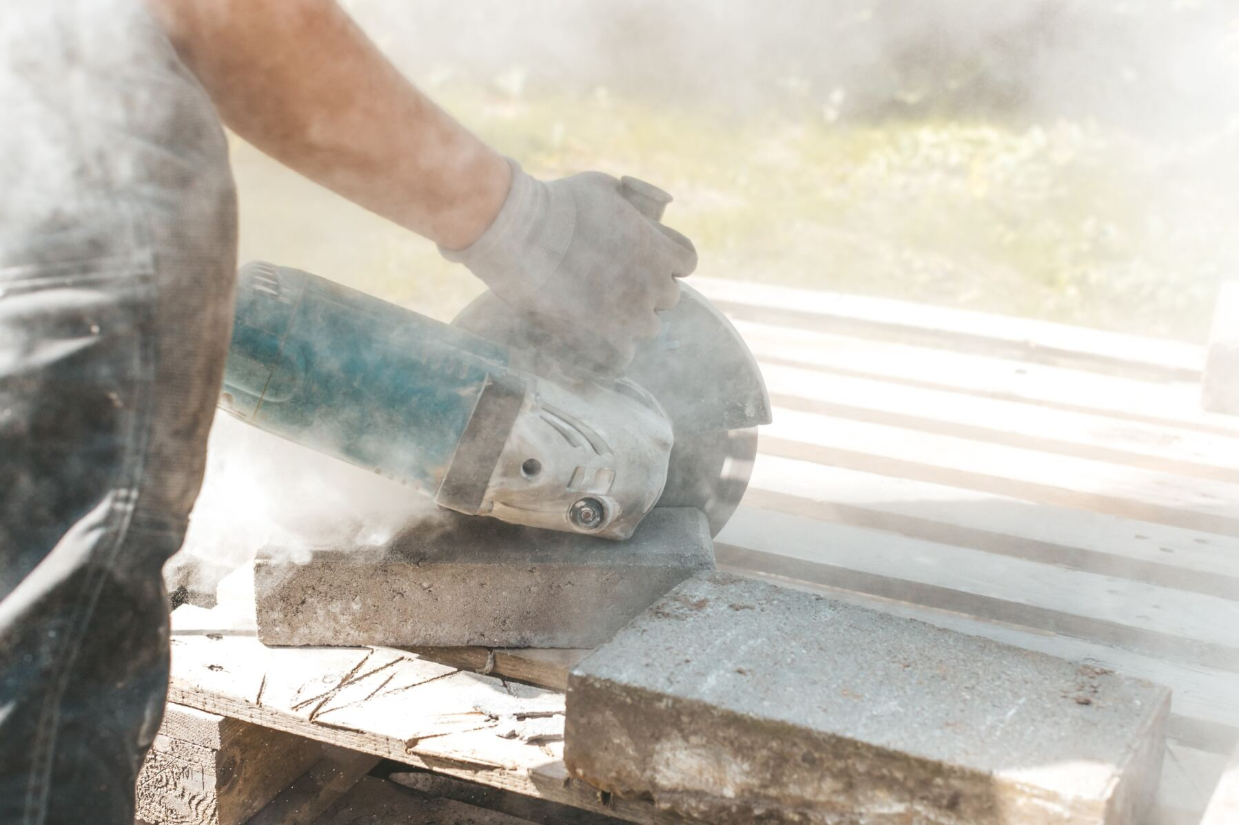
What is silica?
Naturally occurring mineral
Found in soil, sand, granite and many commercial products, such as:
  Engineered (artificial) stone
  Bricks and tiles
  Concrete and cement
  Drywall and mortar.
Notes:
Silica is a naturally occurring mineral that can be found in soil, sand, granite and many commercial products such as:
Engineered (artificial) stone
Bricks and tiles
Concrete and cement
Drywall and mortar.
ASK: Thinking about your worksite, are there any products or materials you work with that contain silica?
Wait for any responses.
There are many examples of silica-containing materials. Always make sure you’re referring to the Safety Data Sheets. They should declare the concentration of silica in each material.

Slide 5
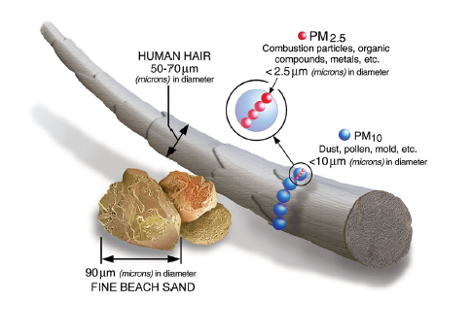
What is silica dust?
Generated when silica-containing materials are cut, crushed, drilled, ground, polished, sanded, sawed or disturbed with force
Can stay in the air and be easily inhaled.
Notes:
Silica dust is generated when silica-containing products are cut, crushed, drilled, ground, polished, sanded, sawed or disturbed with such force.
Common examples of manufacturing processes that pose a risk are the ones that are high energy cutting and drilling or any work that generates a lot of dust in enclosed, poorly ventilated spaces. This can include:
Abrasive blasting if the blasting is medium or the surface contains silica​
Mould and core making​
Sand preparation​
Shakeout and sand reclamation​
Cutting, drilling, polishing, sanding or otherwise processing engineered and natural stones, ceramics, clay, concrete, cement, or other aggregates.
Silica dust particles are small enough to stay in the air. Respirable silica dust is smaller than a single strand of hair, represented by the small blue circles in the picture. When breathed in, silica dust particles penetrate deep into the lungs. It is safest to assume that if you are working on any silica-containing material, you may be exposed to the fine and invisible silica dust.

Slide 6
Why is silica dust harmful?
Breathing in silica dust can lead to:
  Silicosis
  Lung cancer
  Chronic Obstructive Pulmonary Disease (COPD)
  Rheumatoid arthritis
  Chronic kidney disease
  Other autoimmune conditions.
Notes:
Breathing in silica dust is harmful to your health and can lead to silicosis and other diseases such as lung cancer, Chronic Obstructive Pulmonary Disease (COPD), rheumatoid arthritis, chronic kidney disease and other autoimmune conditions.

Slide 7
It is estimated that almost 600,000 workers are currently exposed to silica dust in Australia.
Notes:
It is estimated that almost 600,000 Australian workers are currently exposed to silica dust.

Slide 8
Reducing exposure
Notes:
We’ve talked about what silica dust is and how it is created. Next, we’ll talk about how to reduce exposure in the workplace.​
​
ASK: Before we start, are there any actions you can think of, that you already take to reduce silica dust exposure?

Slide 9

Reduce and manage your risk by:
Following the Hierarchy of Controls
What is the Hierarchy of Controls?
System for controlling risks in the workplace
Control measures ranked from most effective to least effective.
Notes:
The most effective way to reduce your exposure to silica dust is by following the Hierarchy of Controls.
The Hierarchy of Controls is a system for controlling risks in the workplace, using a ranking approach from most effective to least effective. The Hierarchy of Controls is a system that helps us prioritise and implement effective safety measures to protect ourselves from silica dust exposure. It's like a roadmap for staying safe on the job.
In the following slides, we’re going to run through the Hierarchy of Controls and how it can be applied in manufacturing environments to reduce silica dust exposure.

Slide 10
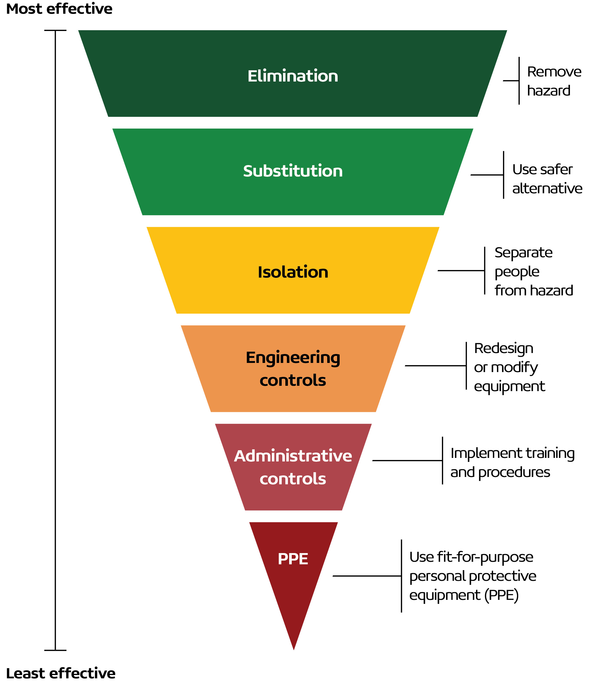

Not using silica-containing materials or processes that generate dust.
Notes:
There are six measures starting with the most effective to the least effective. Elimination is considered the most effective because it removes the hazard entirely.
It may not always be possible to eliminate silica dust from the workplace. If you cannot eliminate it, you must follow control measures from the highest level of effectiveness to the lowest.

Slide 11

Using alternative materials with lower silica content or choosing products that do not contain silica.
Notes:
The next most effective control is substitution. This involves using alternative materials that have a lower silica content or choosing products that do not contain silica.​
​
This can look like: ​
Using natural lower silica content materials instead of engineered (artificial) stone in cabinet manufacturing ​
Using alternatives to silica-based sand in foundry moulds or cores and ensure suitable moisture content. ​
​

Slide 12


Separating workers from silica dust.
Notes:
The next control is isolation. These controls aim to physically separate workers from hazards like silica dust. Essentially, they put a barrier between us and the danger.​
​
We can do that by:​
​Having designated enclosed areas for dust generating work such as sealed blast chambers, glove boxes, fume hoods or cabinets​
Providing barriers that can be installed temporarily around work that will generate silica dust​
Providing designated enclosed and clean areas for rest and breaks without silica dust​
Scheduling work to minimise multiple trades being exposed to dust generating work.

Slide 13


Redesigning or modifying equipment and processes.
Notes:
Engineering controls involve redesigning or modifying equipment and processes of the workplace to reduce silica dust exposure. ​
​
This can look like:​
On-tool extraction and dust suppression by water sprays, extraction or dilution ventilation. This will capture dust at the source and reduce airborne particles​
Ensuring materials are sufficiently wet at all stages of work, including when working on materials. Watering the material prior to starting work is not sufficient, misting should continue during and for some time after power tool work is complete ​
Ensuring areas where silica dust may be present are well ventilated with local exhaust ventilation, enclosures, or hoods and a supply of clean, fresh air is provided​
Using fibre cement shears instead of other saws.​
​
ASK if relevant: Can you name any tools that we use that apply here? OR What tools or processes do you think we can modify to reduce silica dust exposure?

Slide 14

Implementing training and procedures.
Notes:
Administrative controls are policies, procedures, and practices that help manage silica dust exposure through work organisation and planning.​
​
This can include:​
Following administrative policies such as Safe Work Method Statements and other relevant training​
Using binders or sand delivery processes to reduce loose sand ​
Washing facilities to remove dust from clothes and boots​
Ensuring areas where silica containing products are worked on, including machinery, are regularly cleaned with an industrial high-efficiency particulate air filter vacuum​
Shift rotation policies that may apply to workers exposed to silica dust to reduce exposure.​
​
ASK if relevant: ​
What training might be useful to implement to work safety around silica dust?​
Does everyone know where they can find information like Safe Work Method Statements or Safety Data Sheets?

Slide 15



Using fit-for-purpose PPE.
Never rely solely on PPE to protect you from silica dust.
Notes:
The last and least effective control measure is Personal Protective Equipment (or PPE). You should never rely solely on PPE to protect yourself from silica dust.
Using PPE means that you are:
Wearing approved and correctly fitted respiratory protective equipment. This includes face fit testing to ensure a proper seal
Following the correct use, cleaning and storage of the equipment.
ASK if relevant:
Do you feel confident in wearing PPE?
When did you last get your PPE checked?
Is there any PPE that you feel that you need?

Slide 16

What could you be doing differently in the workplace to reduce your exposure to silica dust?
Notes:
Let’s have a quick discussion.
Thinking about everything we’ve gone over with the Hierarchy of Controls, what could you be doing differently in the workplace to reduce your exposure to silica dust?
How confident do you feel working around silica dust? Do you feel confident that you can adequately work to reduce your risk?

Slide 17


Takeaways from today
Follow the Hierarchy of Controls to reduce exposure to silica dust
Talk to your doctor about your workplace exposure
Visit Lung Foundation Australia’s website for more resources.
Notes:
To wrap this up, let’s go over the takeaways from today:
Follow the Hierarchy of Controls to reduce exposure to silica dust
Talk to your doctor about your workplace exposure. It is important for your doctor to know so they can better monitor your overall wellbeing
Visit Lung Foundation Australia’s website for more resources.
If you’re wanting to find out more information and better understand the risks to lung health in the workplace and safety practices that can help protect you, visit Lung Foundation Australia and take the Healthy Lungs at Work Quiz.

Slide 18
For more information w: lungfoundation.com.au p: free call 1800 654 301

