Slide 1

Silica dust in The
Tunnelling industry
Toolbox Talk
Notes:
Description: This Toolbox Talk is intended for workers and to be delivered by PCBU/s, employers, HSRs, supervisors or other similar type roles.

Slide 2




Toolbox Talk: Overview
Exposure to silica dust
When and how silica dust is generated
Using the Hierarchy of Controls to reduce silica dust exposure
Notes:
Today we’re going to go over:
What silica dust is and why it’s harmful
How we can reduce exposure to silica dust in the workplace
Understanding and applying the Hierarchy of Controls.

Slide 3


What is silica dust and why is it harmful?
Notes:
Let’s start with understanding what silica dust is and why it’s harmful.

Slide 4
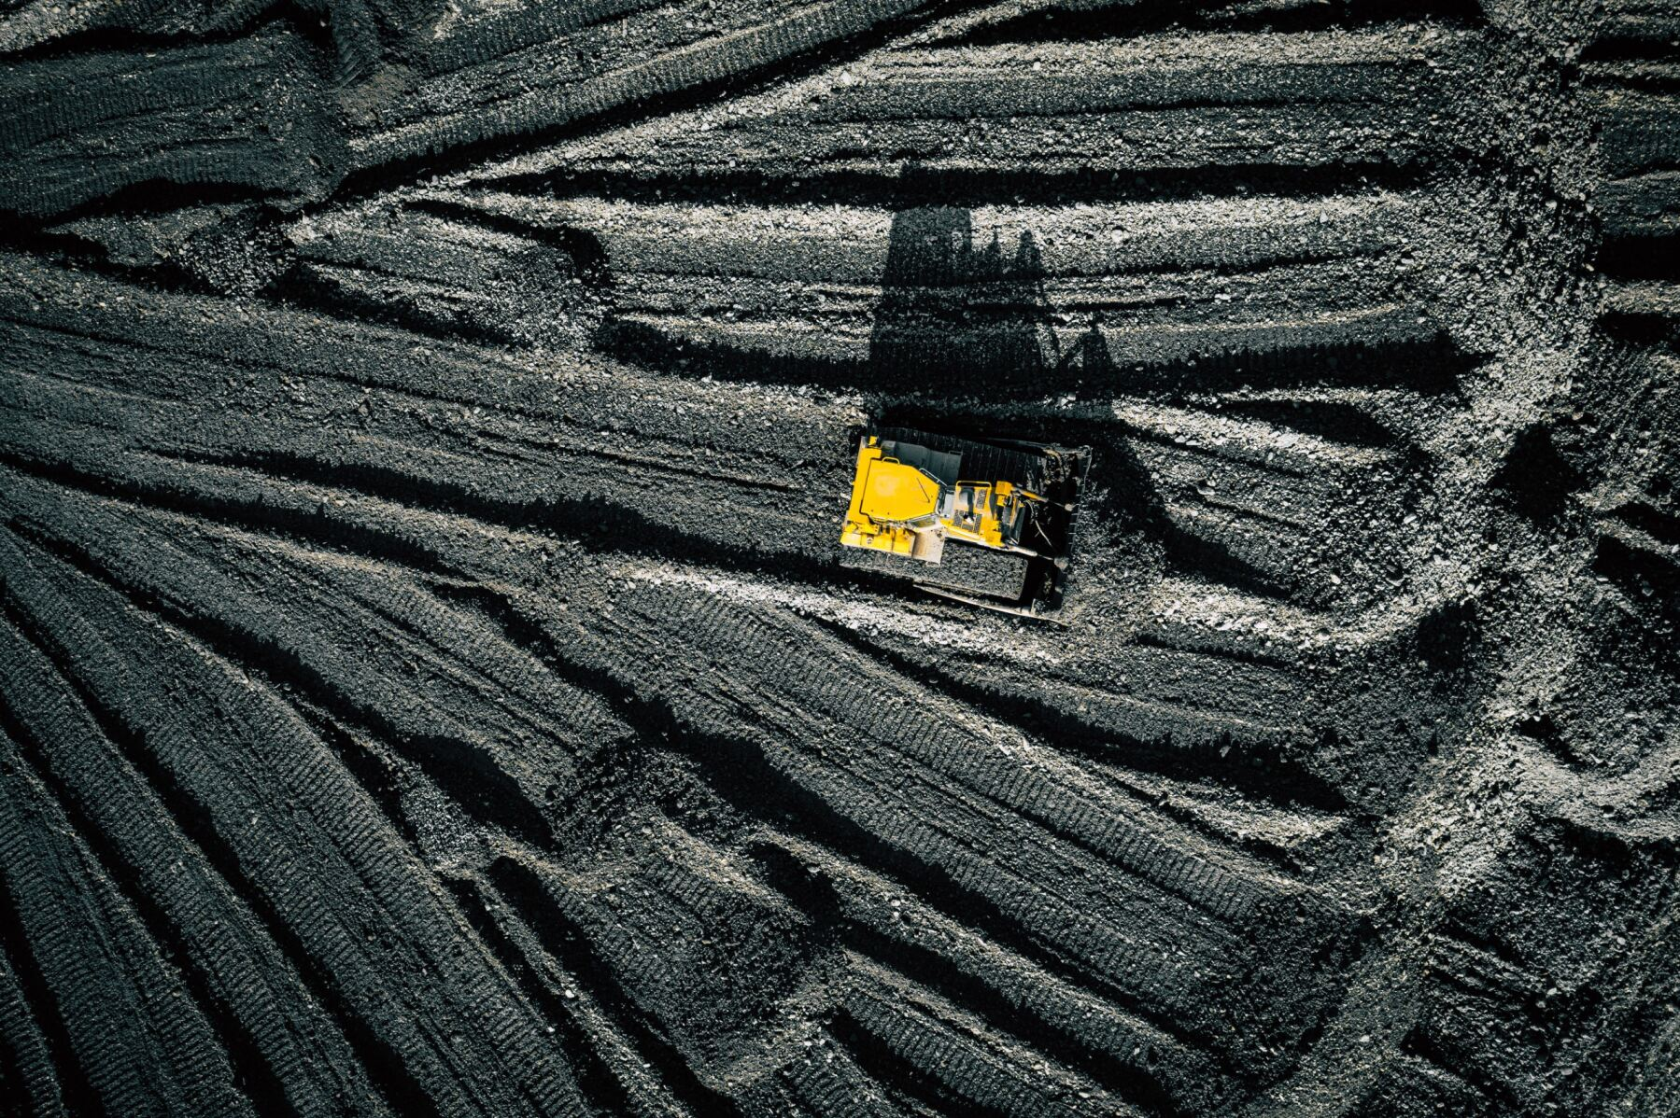
What is silica?
Naturally occurring mineral
Found in soil, sand, granite and many commercial products, such as:
  Engineered (artificial) stone
  Bricks and tiles
  Concrete and cement
  Drywall and mortar.
Notes:
Silica is found in most tunnelling operations because it occurs naturally in the earth’s crust. It can be found in most rock, limestone, and sandstone. ​
​
ASK: Thinking about the worksite, where or when do you think you would encounter silica-containing materials?​
Wait for any responses.

Slide 5
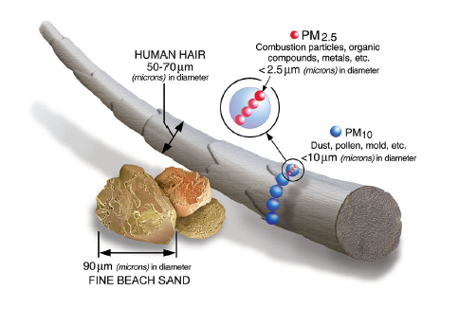
What is silica dust?
Generated when silica-containing materials are cut, crushed, drilled, ground, polished, sanded, sawed or disturbed with force
Can stay in the air and be easily inhaled.
Notes:
Silica dust is generated when silica-containing products are cut, crushed, drilled, ground, polished, sanded, sawed or disturbed with such force.​
​
Common examples of tunnelling processes that pose a risk are the ones that are high energy cutting and drilling or any work that generates a lot of dust. This can include: ​
​Tunnelling into rock such as sandstone and shale
Shotcreting
Heavy plant transporting spoil
Loaders picking up and moving spoil
Crushing, loading, hauling, and dumping of rock, or muck from tunnelling
Relocating ventilation.
Silica dust particles are small enough to stay in the air. Respirable silica dust is smaller than a single strand of hair, represented by the small blue circles in the picture. When breathed in, silica dust particles penetrate deep into the lungs. It is safest to assume that if you are working on any silica-containing material, you may be exposed to the fine and invisible silica dust.

Slide 6
Why is silica dust harmful?
Breathing in silica dust can lead to:
  Silicosis
  Lung cancer
  Chronic Obstructive Pulmonary Disease (COPD)
  Rheumatoid arthritis
  Chronic kidney disease
  Other autoimmune conditions.
Notes:
Breathing in silica dust is harmful to your health and can lead to silicosis and other diseases such as lung cancer, chronic obstructive pulmonary disease (COPD), rheumatoid arthritis, chronic kidney disease and other autoimmune conditions.

Slide 7
It is estimated that almost 600,000 workers are currently exposed to silica dust in Australia.
Notes:
It is estimated that almost 600,000 Australian workers are currently exposed to silica dust.

Slide 8
Reducing exposure
Notes:
We’ve talked about what silica dust is and how it is created. Next, we’ll talk about how to reduce exposure in the workplace.​
​
ASK: Before we start, are there any actions you can think of, that you already take to reduce silica dust exposure?

Slide 9

Reduce and manage your risk by:
Following the Hierarchy of Controls
What is the Hierarchy of Controls?
System for controlling risks in the workplace
Control measures ranked from most effective to least effective.
Notes:
The most effective way to reduce your exposure to silica dust is by following the Hierarchy of Controls.
The Hierarchy of Controls is a system for controlling risks in the workplace, using a ranking approach from most effective to least effective. The Hierarchy of Controls is a system that helps us prioritise and implement effective safety measures to protect ourselves from silica dust exposure. It's like a roadmap for staying safe on the job.
In the following slides, we’re going to run through the Hierarchy of Controls and how it can be applied in tunnelling environments to reduce silica dust exposure.

Slide 10
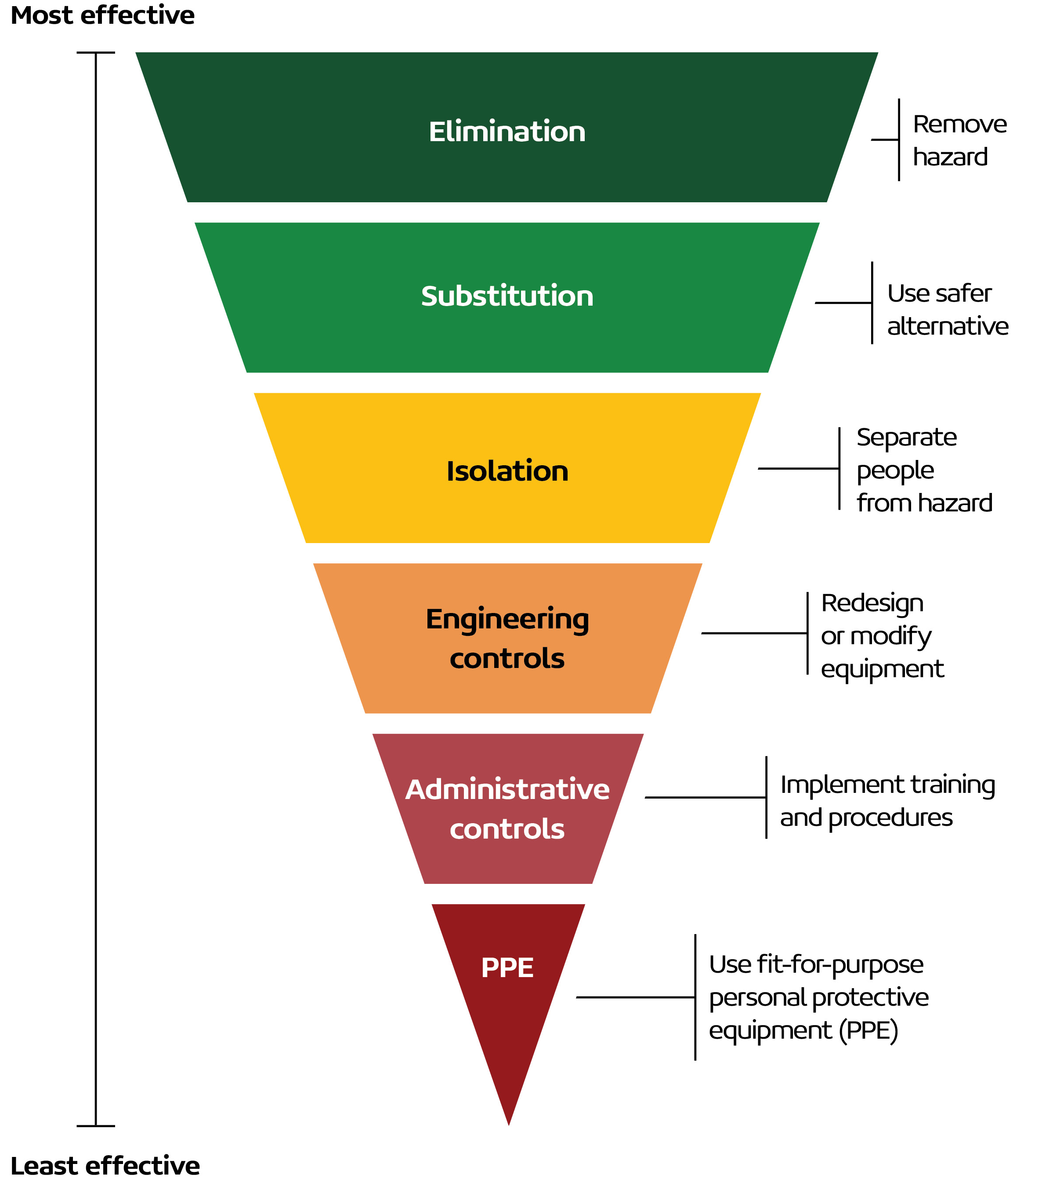

Not using silica-containing materials or processes that generate dust.
Notes:
There are six measures starting with the most effective to the least effective. Elimination is considered the most effective because it removes the hazard entirely.
It may not always be possible to eliminate silica dust from the workplace. If you cannot eliminate it, you must follow control measures from the highest level of effectiveness to the lowest.

Slide 11

Using alternative materials with lower silica content or choosing products that do not contain silica.
Notes:
The next most effective control is substitution. This involves using alternative materials that have a lower silica content or opting for lower dust generating processes.​
​
This can look like: ​
Use of lower energy rock breaking methods or moving from dry to wet drilling.
​
​

Slide 12


Separating workers from silica dust.
Notes:
The next control is isolation. These controls aim to physically separate workers from hazards like silica dust. Essentially, they put a barrier between us and the danger.​
​
We can do that by:​​
Enclosures around transfer points including covered conveyors and stockpiles or the use of curtains
Vehicles with an enclosed pressurised cabin and door seals
Designated enclosed and clean areas for rest and breaks without silica dust.

Slide 13


Redesigning or modifying equipment and processes.
Notes:
Engineering controls involve redesigning or modifying equipment and processes of the workplace to reduce silica dust exposure. ​
​
This can look like:​
The ventilation system should be designed to provide clean air throughout the tunnel during construction, tunnel use and maintenance
Localised extraction ventilation for dust during excavation, post-blasting, operating a large plant and other activities such as maintenance
Cross passage ventilation and face extraction ventilation
On-tool dust extraction at key dust sources of tunnel boring machines (TBMs) at the cutter head and conveyor transfer point
Using water sprays on cutting equipment or over muck heaps and spoil conveyors
Changing the direction of the exhaust of tunnel vehicles (from pointing down to pointing up) to minimise the dust that is created.
​
ASK if relevant: Can you name any tools or processes that we use that apply here? OR What tools or processes do you think we can modify to reduce silica dust exposure?

Slide 14

Implementing training and procedures.
Notes:
Administrative controls are policies, procedures, and practices that help manage silica dust exposure through work organisation and planning.​
​
This can include:​
Washing facilities to remove dust from clothes and boots
Areas where silica containing dust has deposited or accumulated are regularly wiped or cleaned with an industrial high-efficiency particulate air filter vacuum
Inspection plans to compare the actual geological conditions as the excavation progresses with the assumed conditions
Shift rotation policies to reduce exposure
Avoiding disturbance of dried mud, slurry and spoil
Following administrative policies such as Safe Work Method Statements (SWMS) and other training as provided by your employer
​
ASK if relevant: ​
What training might be useful to implement to work safety around silica dust?​
Does everyone know where they can find information like Safe Work Method Statements?

Slide 15



Using fit-for-purpose PPE.
Never rely solely on PPE to protect you from silica dust.
Notes:
The last and least effective control measure is Personal Protective Equipment (or PPE). You should never rely solely on PPE to protect yourself from silica dust.
Using PPE means that you are:
Wearing approved and correctly fitted respiratory protective equipment. This includes face fit testing to ensure a proper seal
Following the correct use, cleaning and storage of the equipment.
ASK if relevant:
Do you feel confident in wearing PPE?
When did you last get your PPE checked?
Is there any PPE that you feel that you need?

Slide 16

What could you be doing differently in the workplace to reduce your exposure to silica dust?
Notes:
Let’s have a quick discussion.
Thinking about everything we’ve gone over with the Hierarchy of Controls, what could you be doing differently in the workplace to reduce your exposure to silica dust?
How confident do you feel working around silica dust? Do you feel confident that you can adequately work to reduce your risk?

Slide 17

Takeaways from today
Follow the Hierarchy of Controls to reduce exposure to silica dust
Talk to your doctor about your workplace exposure
Visit Lung Foundation Australia’s website via the QR code for more resources.
Notes:
To wrap this up, let’s go over the takeaways from today:
Follow the Hierarchy of Controls to reduce exposure to silica dust
Talk to your doctor about your workplace exposure. It is important for your doctor to know so they can better monitor your overall wellbeing
Visit Lung Foundation Australia’s website by scanning the QR code for more resources. You can also take the Healthy Lungs at Work Quiz to better understand the risks to lung health in the workplace and safety practices that can help protect you.

Slide 18
For more information w: lungfoundation.com.au p: free call 1800 654 301

