Slide 1
COPD resources for Aboriginal and Torres Strait Islander Health Workers and Practitioners
Breathe Easy Walk Easy Lungs for Life (BE WELL) resources for Aboriginal and Torres Strait Islander Health Workers and Practitioners
Notes:
https://pulmonaryrehab.com.au/additional-resources/aboriginal-and-torres-strait-islander-health-workers-and-practitioners/
These resources have been developed to assist Aboriginal and Torres Strait Islander Health Workers and Practitioners yarn about Chronic Obstructive Pulmonary Disease (COPD) with Aboriginal and/or Torres Strait Islander peoples living with COPD.
Aboriginal and/or Torres Strait Islander Health Workers and Practitioners may work together with doctors, physiotherapists, exercise physiologists, nurses, psychologists, dietitians and other health professionals to provide high quality care.
These resources are to guide Aboriginal health workers in yarning about COPD. The language can be changed to suit the local community. Using examples and analogies relevant to each community is encouraged to support understanding.
They were developed as part of the Breathe Easy Walk Easy Lungs for Life (BE WELL) project. The project was a study that partnered with Aboriginal Community Controlled Health Services (ACCHS) to trial the implementation of pulmonary rehabilitation. The Illustrations and Yarning Scripts formed the basis of the education component of the pulmonary rehabilitation program in the study.
The BE WELL project (ACTRN12617001337369) was funded by the National Health and Medical Research Council (NHMRC) Global Alliance for Chronic Diseases (GACD).

Slide 2
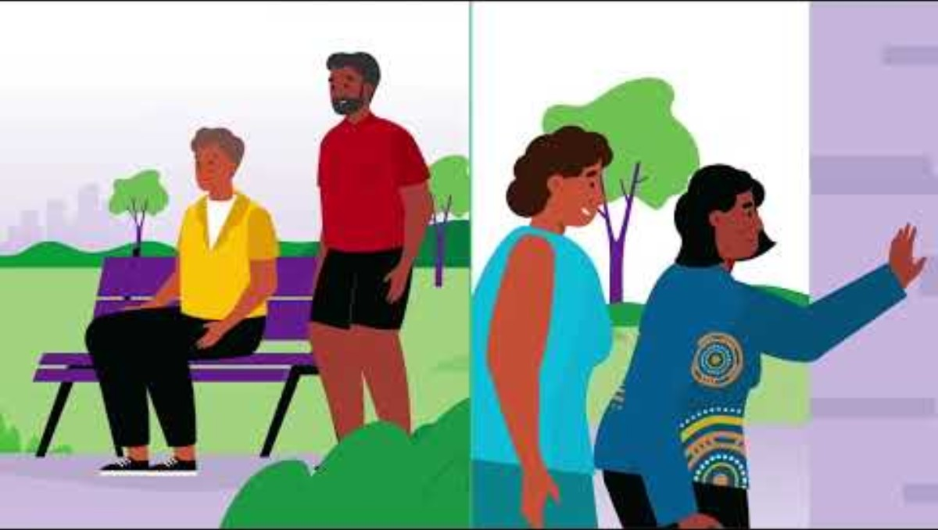
Notes:
Transcript
Do you support people who have Chronic Obstructive Pulmonary Disease or other respiratory diseases?
A variety of resources are available to help you provide care to people with COPD.
When you breath in, air moves through the airways to the air sacs, where oxygen enters the blood and is taken around the body to where it is needed.
In COPD, the airways become narrow and the air sacs get damaged. This makes breathing more difficult.
Medications like inhalers can open the airways, so more air can move in and out of the lungs and make breathing easier.
It is important people are shown how to use their inhalers correctly to get the right amount of medication into their lungs.
Every person with COPD should have an action plan that helps them know what to do if their breathing gets worse.
There are many ways other than medications that can help someone with COPD to stay well and active.
Exercise programs help reduce breathlessness and improves strength.
Encourage people with COPD to exercise with others, by joining a pulmonary rehabilitation program. They will learn how to exercise safely and manage breathlessness during exercise and daily activity.
Energy conservation techniques may help manage daily activities, such as walking with a rollator or using a shower chair.
Relaxation techniques may also help people breathe easier during times of stress or anxiety.
And lastly, yarn about healthy eating and food preparation, such as cooking and freezing meals in advance for when they might feel unwell or tired and breathless.
There are many ways you can help people live well with COPD. Having a yarn about these topics is a good start!
Access resources for health professionals, patients and carers at pulmonaryrehab.com.au and lungfoundation.com.au

Slide 3
Illustrations & Yarning Scripts
Breathe Easy Walk Easy Lungs for Life (BE WELL) resources for Aboriginal and Torres Strait Islander Health Workers and Practitioners
Notes:
https://pulmonaryrehab.com.au/additional-resources/aboriginal-and-torres-strait-islander-health-workers-and-practitioners/be-well-illustrations-yarning-scripts/
These illustrations and yarning scripts are for Aboriginal and Torres Strait Islander Health Workers and Practitioners. They are used to yarn about chronic obstructive pulmonary disease (COPD) with Aboriginal and/or Torres Strait Islander peoples living with COPD.
There are seven topics:
TOPIC 1: HOW THE LUNGS WORK
TOPIC 2: WHAT HAPPENS IN THE LUNGS IN COPD
TOPIC 3: MEDICATIONS, INHALERS, ACTION PLANS
TOPIC 4: WHY EXERCISE IS IMPORTANT
TOPIC 5: MANAGING BREATHLESSNESS AND HOW TO CONSERVE ENERGY
TOPIC 6: MANAGING ANXIETY AND STRESS
TOPIC 7: HEALTHY EATING
The language can be changed to suit the local community. Using examples and analogies relevant to each community is encouraged to support understanding.
Aboriginal and/or Torres Strait Islander Health Workers and Practitioners may work together with doctors, physiotherapists, exercise physiologists, nurses, psychologists, dietitians and other health professionals to provide high quality care for people living with COPD.
These resources were developed as part of the Breathe Easy Walk Easy Lungs for Life (BE WELL) project. The project was a study that partnered with Aboriginal Community Controlled Health Services (ACCHS) to trial the implementation of pulmonary rehabilitation. The Illustrations and Yarning Scripts formed the basis of the education component of the pulmonary rehabilitation program in the study.
The BE WELL project (ACTRN12617001337369) was funded by the National Health and Medical Research Council (NHMRC) Global Alliance for Chronic Diseases (GACD).

Slide 4
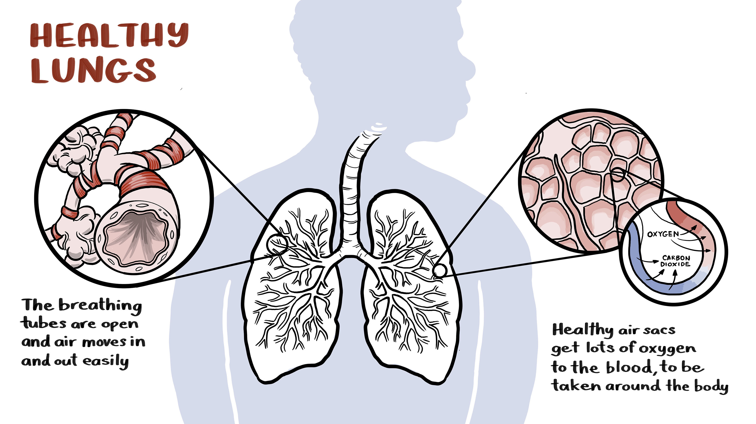
Notes:
Healthy Lungs – Yarning illustration 1
There are 2 lungs (left and right) that sit inside the ribs. The purpose of the lungs is to get fresh air (oxygen – “good air”) into the body and remove old air (carbon dioxide – “bad air”).
When breathing in, the air enters the lungs through the nose and mouth and travels down the windpipe (trachea). Next it goes through the airways (bronchi) to the air sacs (alveoli).
When the (oxygen) reaches the air sacs (alveoli) it meets with small blood vessels (capillaries). Here, the oxygen moves into the blood and is taken around the body to where it is needed. The old air (carbon dioxide) moves out of the blood into the air sacs and is breathed out.

Slide 5
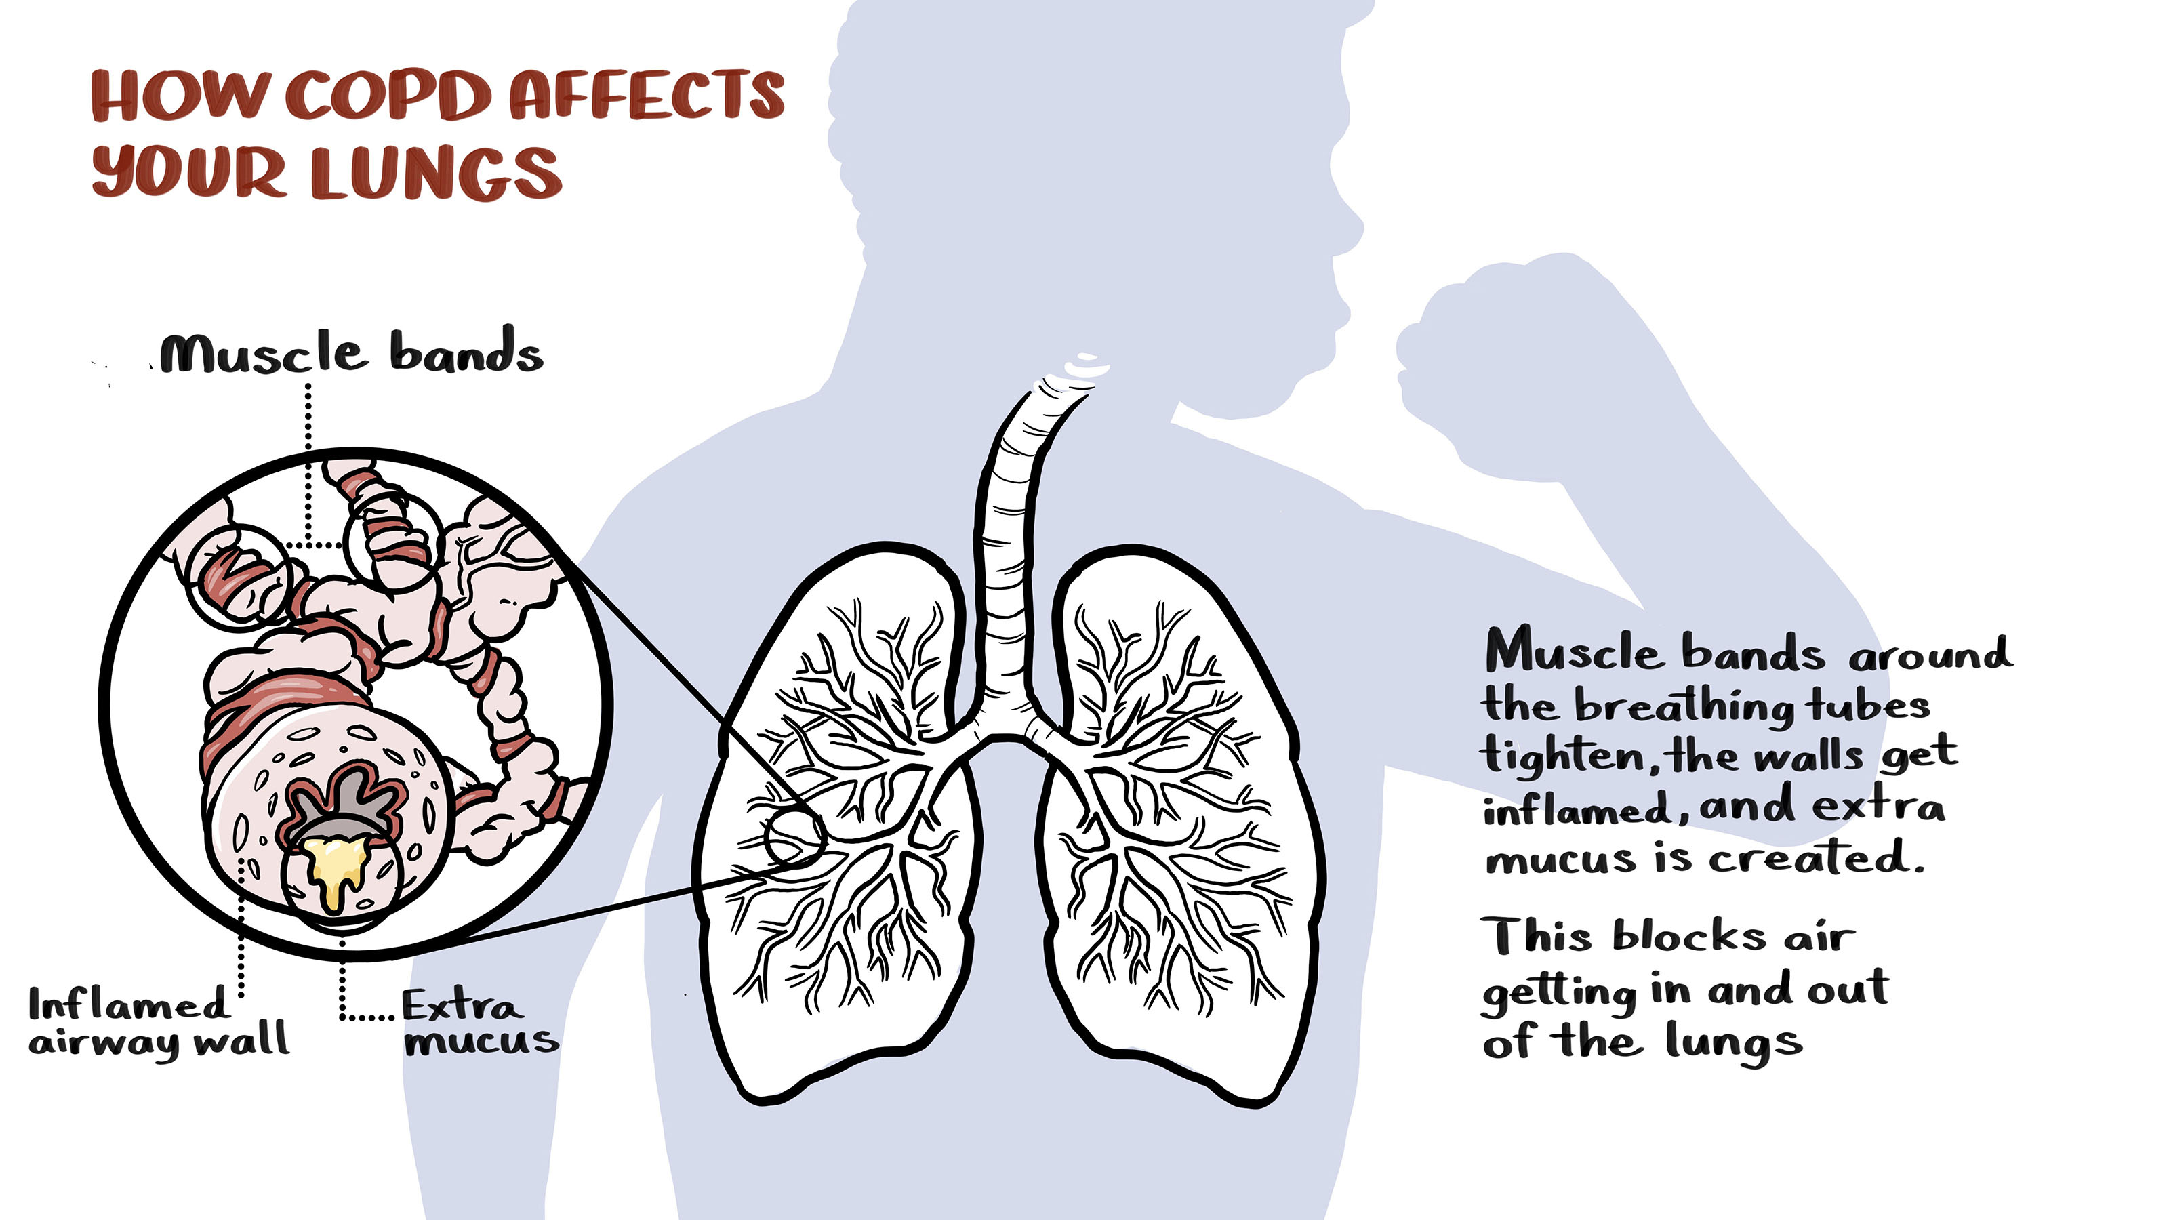
Notes:
What happens in the lungs in COPD – Yarning illustration 2a
If someone has COPD, the lungs change:
The airways narrow (Yarning illustration 2a).
This is because:
the walls of the airways become inflamed (swollen),
the small muscle bands around the airways tighten and
more mucus/spit is produced and partly fills the airways.
Narrow airways means less air flows in and out of the lungs.
These changes are sometimes called chronic bronchitis

Slide 6
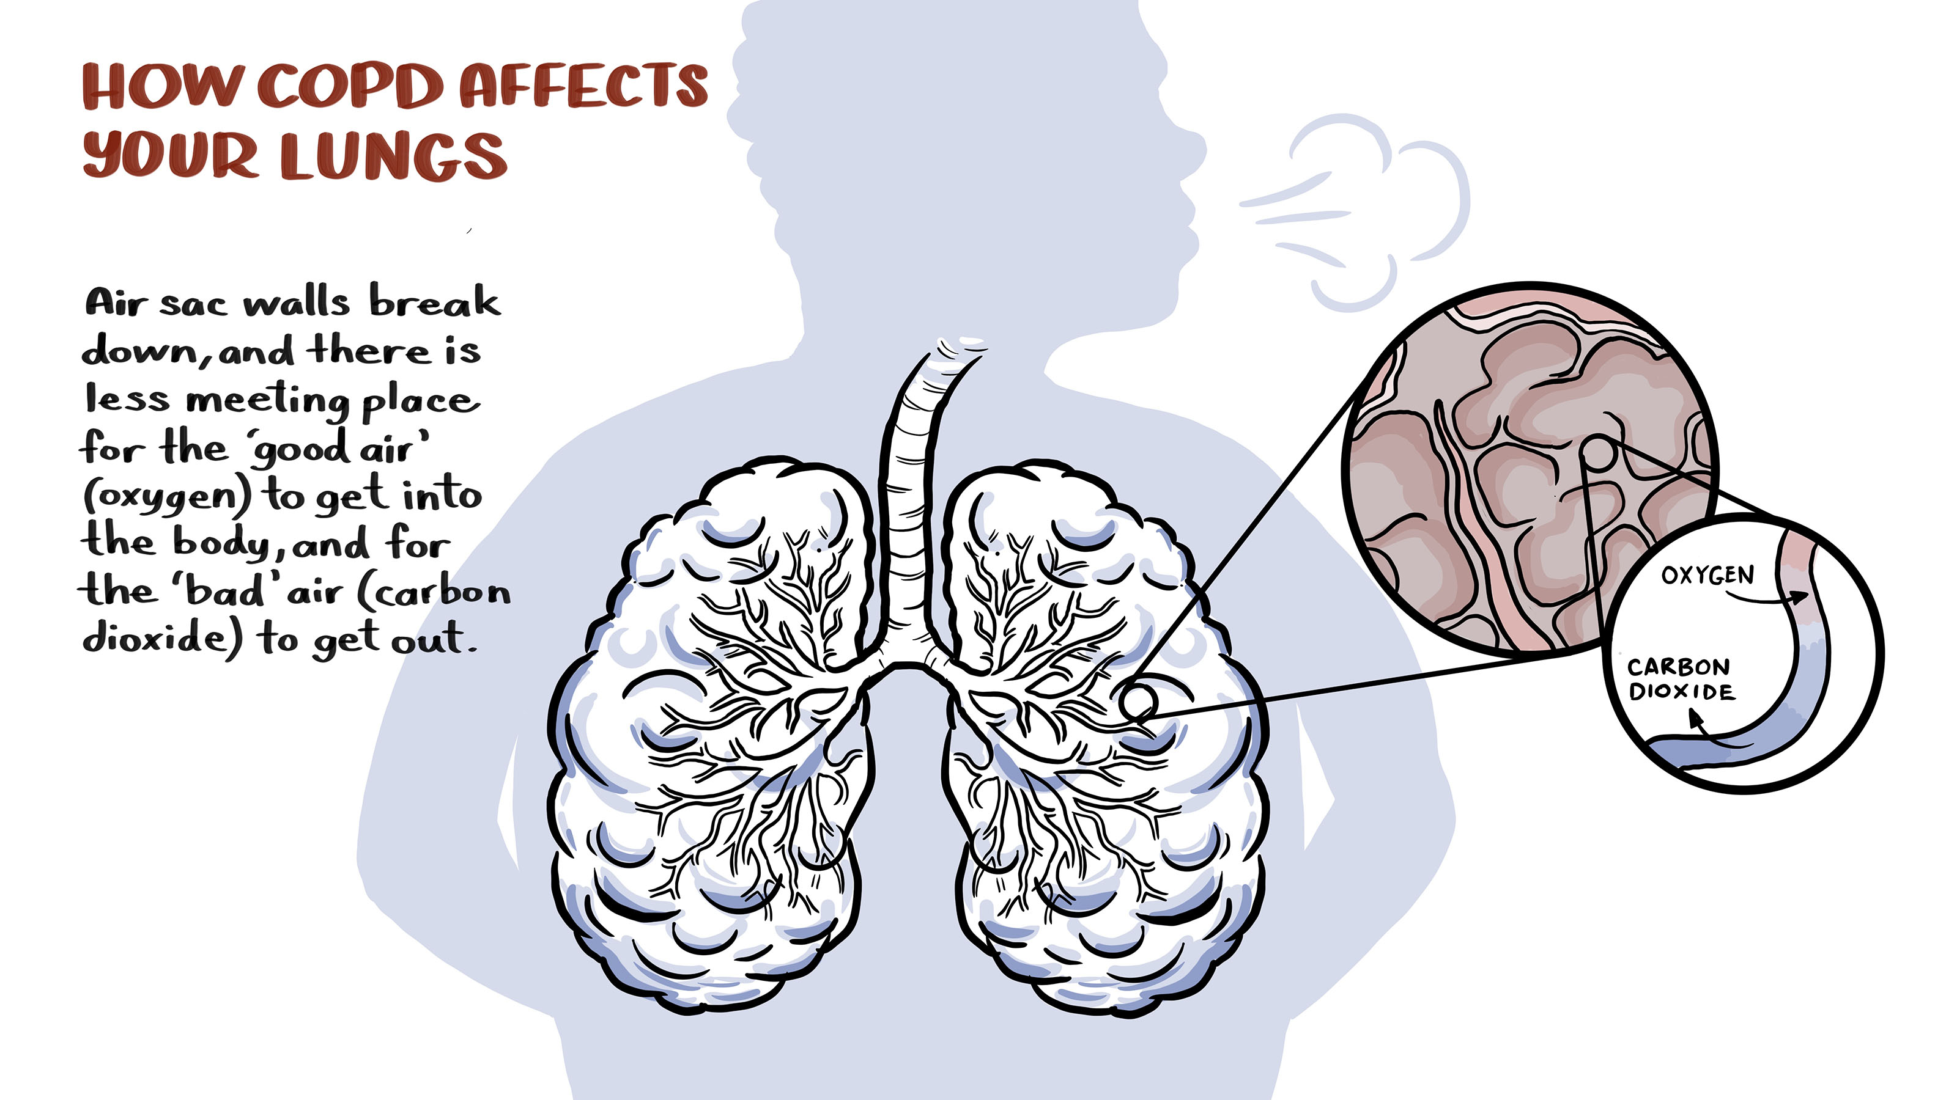
Notes:
What happens in the lungs in COPD – Yarning illustration 2b
The air sacs are damaged (Yarning illustration 2b).
There are less ‘meeting places’ where oxygen moves into the blood and carbon dioxide moves out. This damage to the air sacs is called emphysema.
Health Professional Note: for additional resources to understand symptoms and management of COPD, including chronic bronchitis and emphysema, access COPD page on the LFA website.

Slide 7
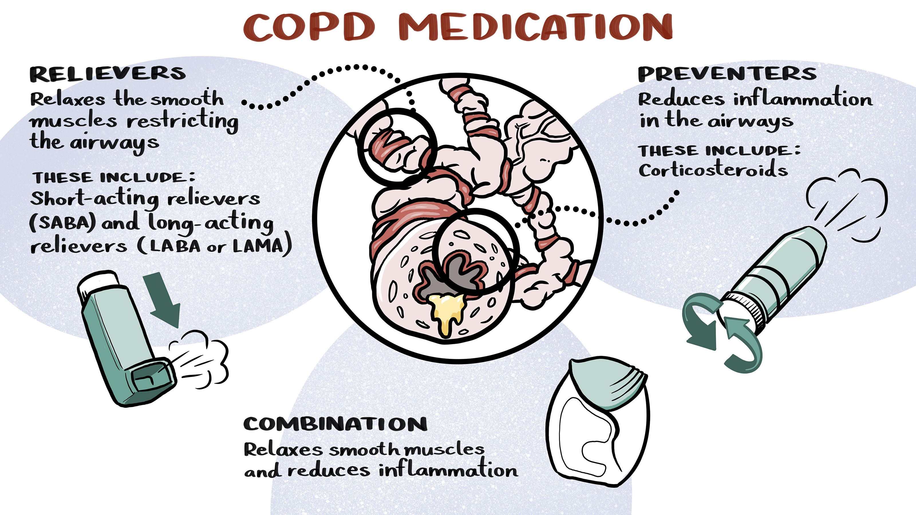
Notes:
Medications and how to use inhalers – Yarning illustration 3a
Some medications help open the airways (i.e. make them less narrow) and let more air move in and out of the lungs (Yarning illustration 3a).
These medications are:
Relievers that relax the small muscles around the airways.
Note for health professionals: for example, Ventolin is a short acting beta agonist (SABA) or Onbrez Breezhaler which is a long-acting beta agonist (LABA) or Spiriva which is a long-acting muscarinic antagonist (LAMA).
Preventers reduce the inflammation of the airway walls.
Note for health professionals: for example inhaled corticosteroids (ICS) such as Fluticasone.
Sometimes these reliever and preventer medications are put together in in a combination therapy inhaler (for example, Seretide).
Health professional resource: Chart of Inhalers for COPD provides the names of most of the inhaled medications currently prescribed.

Slide 8
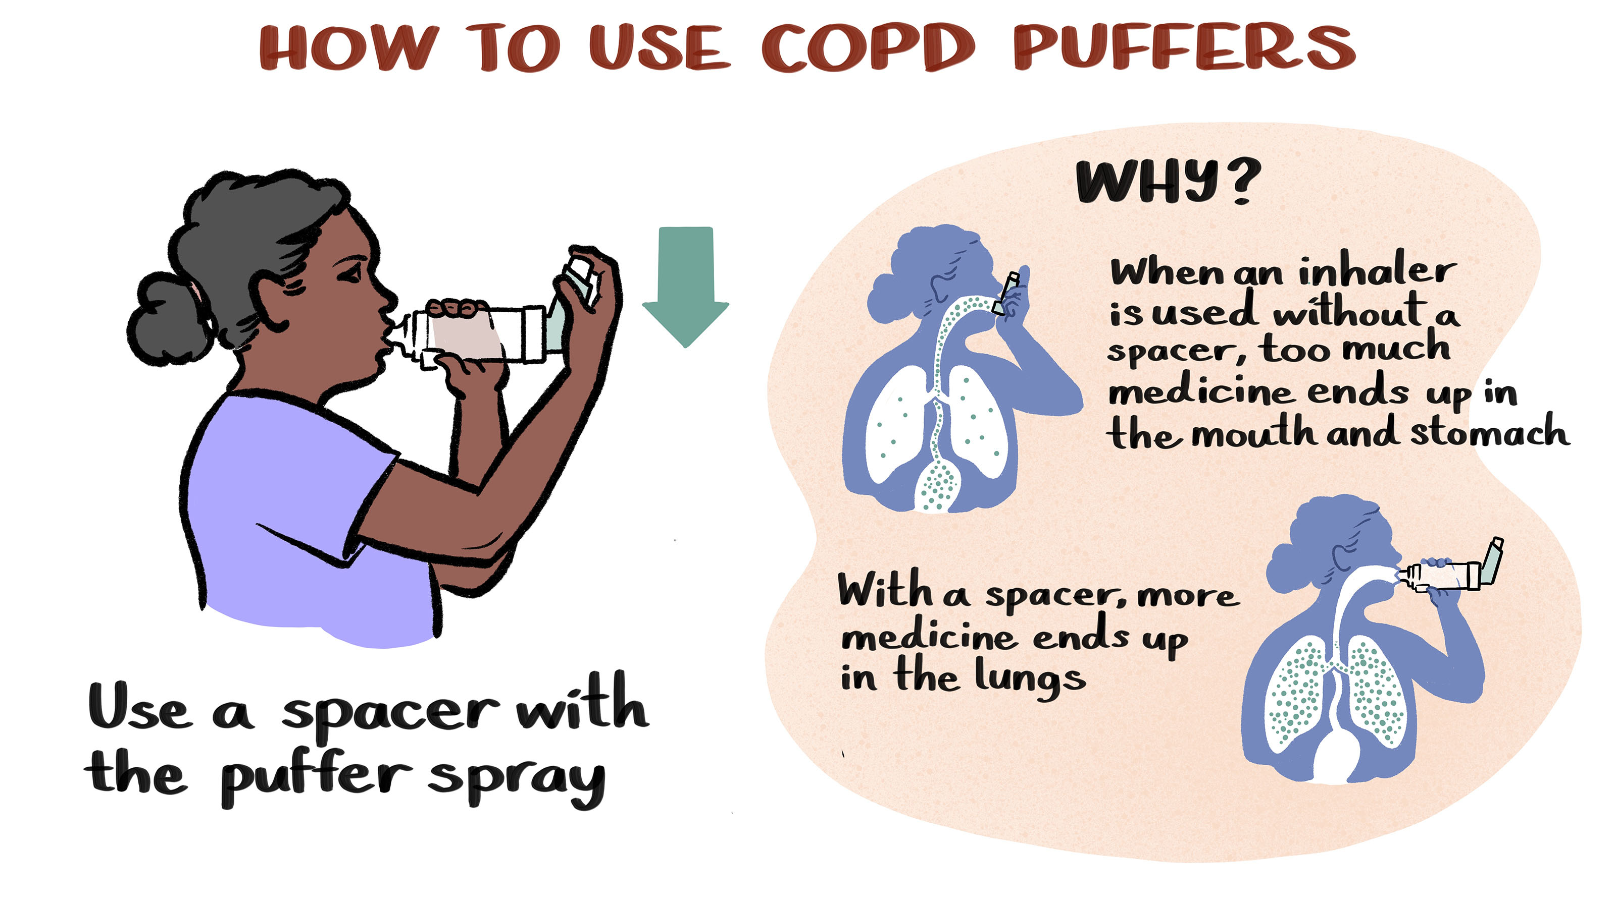
Notes:
Learning how to take inhalers – Yarning illustration 3b
Taking inhaled medications correctly is very important for managing COPD.
Inhaler medications come in lots of different types of devices. Each device has different instructions for how to prepare, use and look after it.
If a person is using a ‘puffer spray’ then using a spacer will help to get the most medication into the lungs where it is needed.
Yarning illustration 3b shows that without a spacer most of the medication (little dots in the picture above) goes into the stomach. With the spacer most of the medication goes into the lungs where it is needed.
Health professional resource: Resources on how to use different inhalers
You may like to watch the relevant video/s with the person living with COPD to make sure they are using their inhalers correctly.

Slide 9
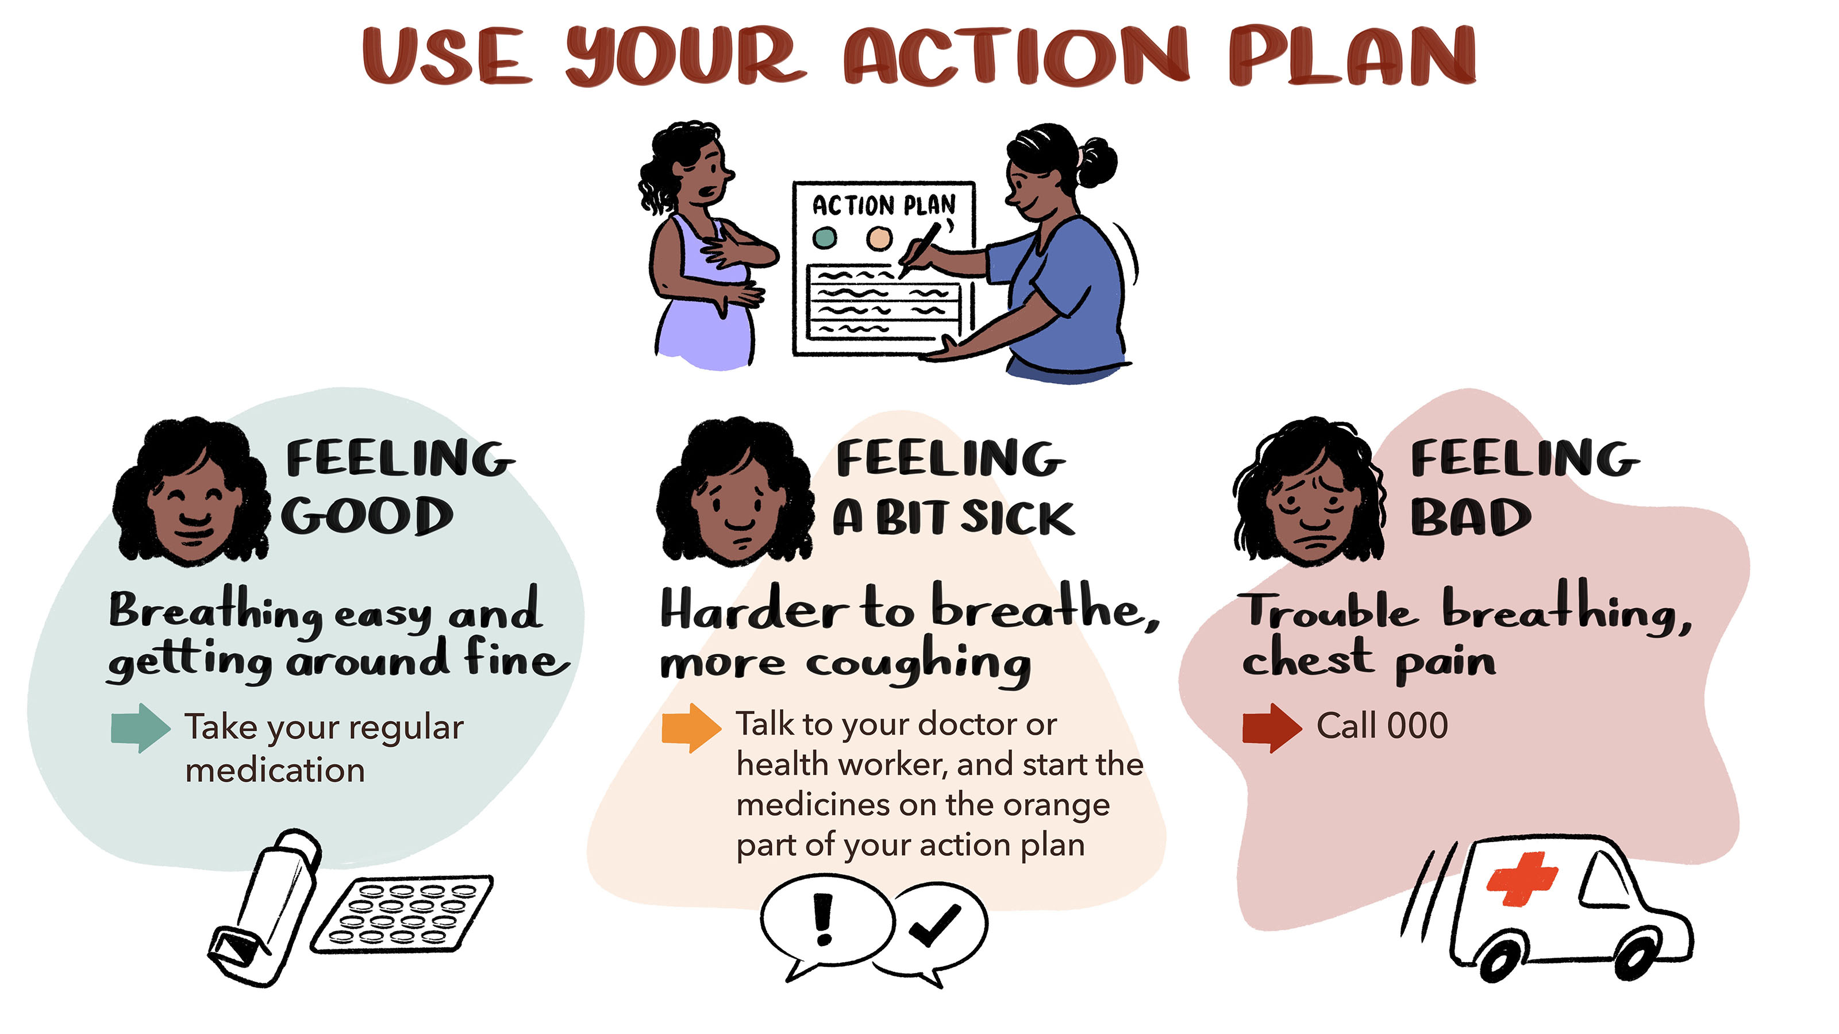
Notes:
Action Plans – Yarning Illustration 4
It is very important for a person living with COPD to have a COPD Action Plan, so they know what to do if they start to feel sick.
In the action plan is like traffic lights:
the Green section lists the medications that the person takes regularly
the Orange section lists the medications that a person would take if they start to feel a bit sick, such as finding it harder to breathe, more coughing etc. They should also make an appointment to see their doctor.
the Red section is when a person is feeling really sick, such as trouble breathing, chest pain. This is when they should call an ambulance – 000.
If the person does not have an Action Plan, organise an appointment with their doctor so they can develop an Action Plan together.

Slide 10
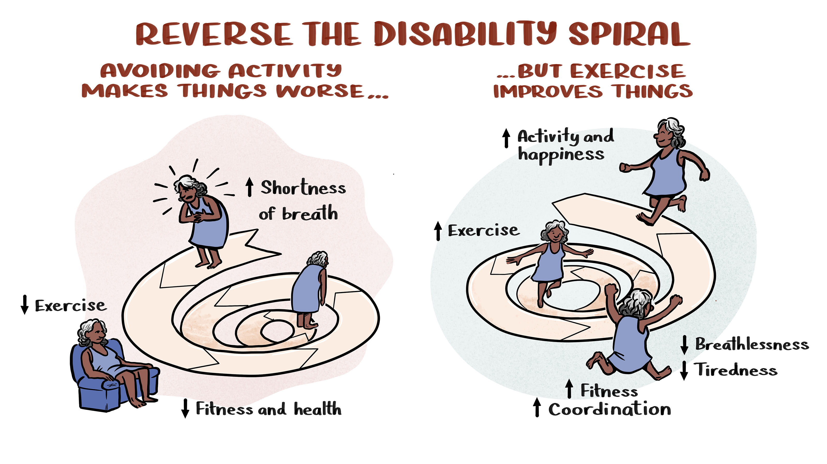
Notes:
Benefits of exercise training: endurance and strength training – Yarning illustrations 5a
What happens if a person doesn’t exercise (Yarning illustrations 5a – left hand side of the illustration).
When people do not exercise or are not physically active they get less fit and weaker.
When a person has COPD, they can become more breathless when they move, which means they are less active. This may mean they get less fit and when doing regular activities such as shopping, cleaning or looking after kids they feel even more breathless. This is called the spiral of inactivity (disability spiral) where the less someone does, the worse they may get and even small amounts of moving may make them breathless.
What changes when a person with COPD does fitness training (Yarning illustrations 5a – right hand).
In a pulmonary rehabilitation program, fitness training like walking on a treadmill, walking on a flat track inside or outside, or riding a stationary cycle aims to reverse this spiral of inactivity (disability spiral) so that a person living with COPD can move more and feel less breathless.

Slide 11
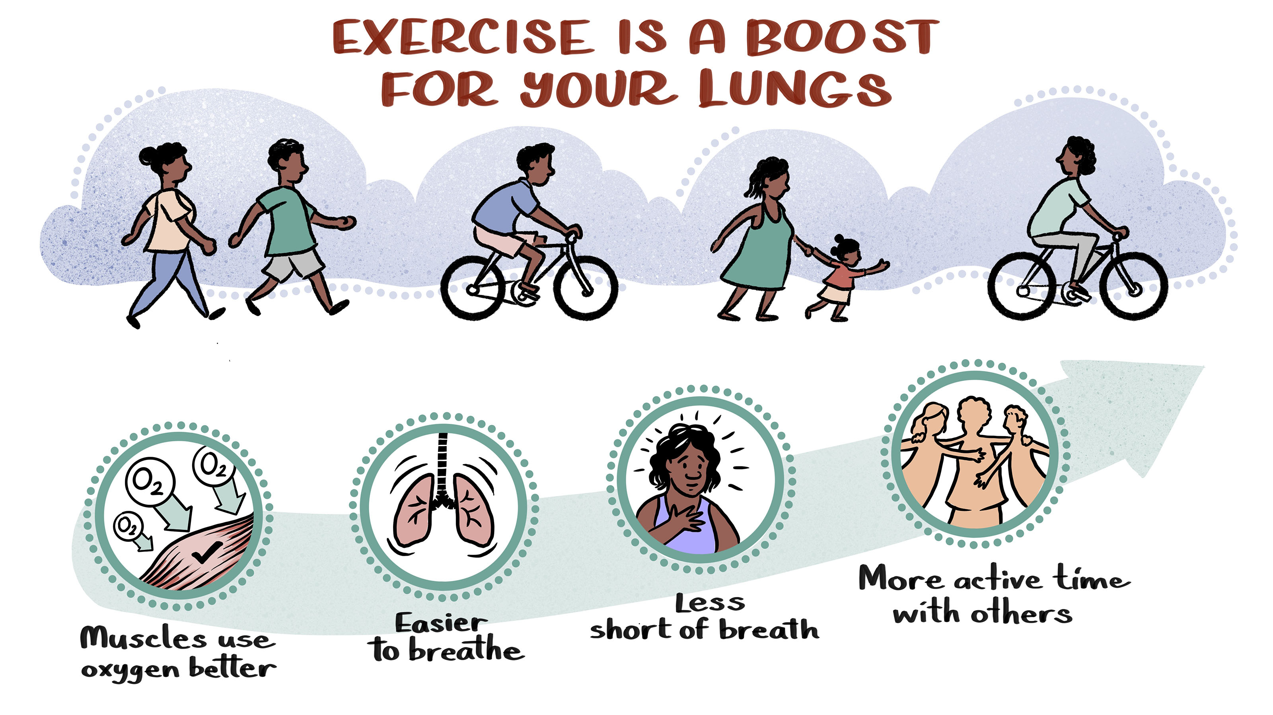
Notes:
Benefits of fitness training – Yarning illustration 5b
This type of fitness training (walking on a treadmill, walking on a flat track inside or outside, or stationary cycling) helps the muscles use oxygen better, breathing improves, and the person will feel less breathless when being active.
This means someone with COPD can do more at home and with family, friends and community.

Slide 12
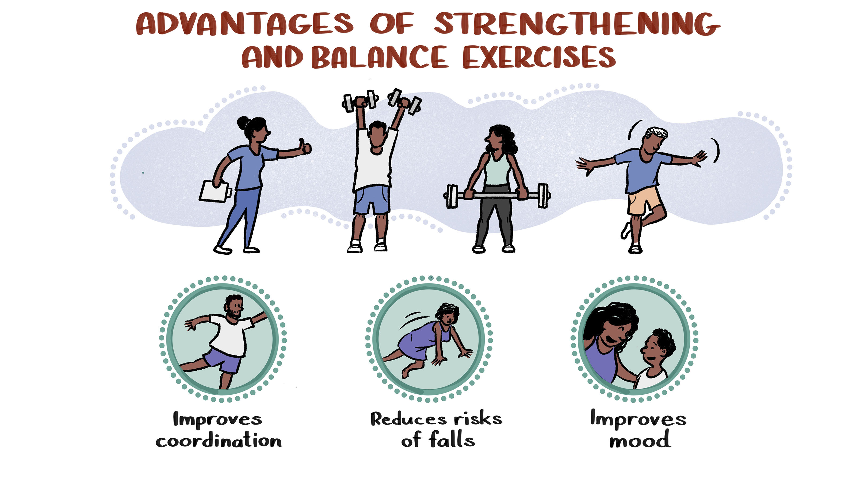
Notes:
Strength and balance training – Yarning illustration 5c
In pulmonary rehabilitation, someone with COPD will also do exercises for their strength and balance, which can help to reduce the risk of falls and make them generally feel better.

Slide 13
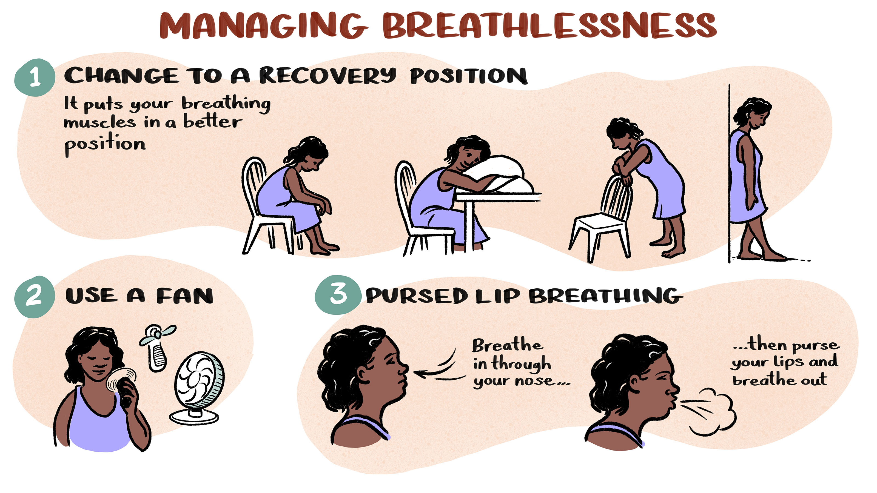
Notes:
Managing breathlessness – Yarning Illustration 6
People with COPD often get breathless when being active or feeling unwell.
There are ways to help manage breathlessness. Using one of the recovery positions helps the breathing muscles to work better. Most of these positions are leaning forward and having the arms supported so the muscles around the neck and upper chest can work better to help breathing.
Using a battery driven hand-held fan can also help by cooling the face.
Pursed-lip breathing when in the recovery positions or when feeling breathless during activity can help reduce breathlessness. Pursed-lip breathing is where a person tightens (‘purse’) their lips, as if they were going to whistle when breathing out through the mouth.

Slide 14
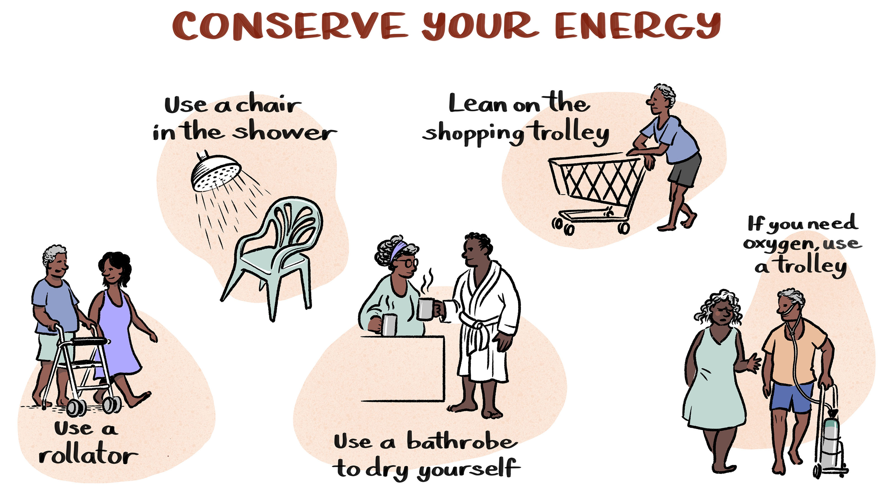
Notes:
Energy conservation – Yarning illustration 7
Although it is very important to do fitness and strength training, sometimes people with COPD may need to conserve energy to manage regular activities.
Tips and tricks to help reduce breathlessness during regular activities:
Using a walking aid (rollator) may help the person to get out and about.
Sitting on a chair or stool while showering.
Using a towelling bathrobe for drying after showering
Leaning on a shopping trolly in the supermarket (this is an example of the recovery position with arms supported that we talked about under managing breathlessness).
If using oxygen, pull it in a light-weight trolley instead of carrying it.

Slide 15
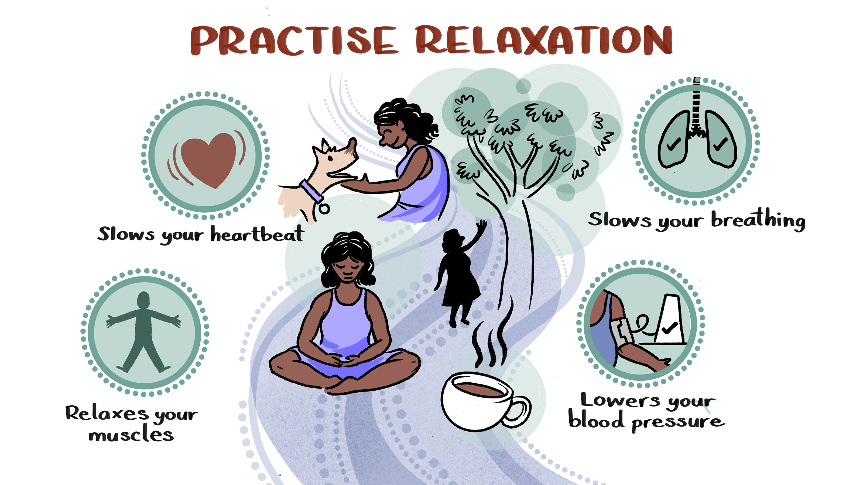
Notes:
Relaxation – Yarning illustration 8
Many people with COPD get stressed or anxious, which can make them feel more breathless.
Learning relaxation techniques is important for managing stress and anxiety. These techniques help to relax the muscles, slow breathing, and lower heart rate and blood pressure.
This means the body is not working as hard and the person may feel calmer and less breathless. Encourage the person with COPD to find out what relaxation techniques work for them, for example sitting quietly outside and thinking about a pleasant calm picture in their mind, having a cup of tea, or talking to or patting their dog or cat.
The healthcare team (including a physiotherapist or exercise physiologist) can help people with COPD to learn these techniques. A person with diagnosed anxiety and/or depression, may be referred to a psychologist for more support.
Professional Note: It might be beneficial to have local/ regional mental health lines on hand that people can call for more support if necessary.

Slide 16
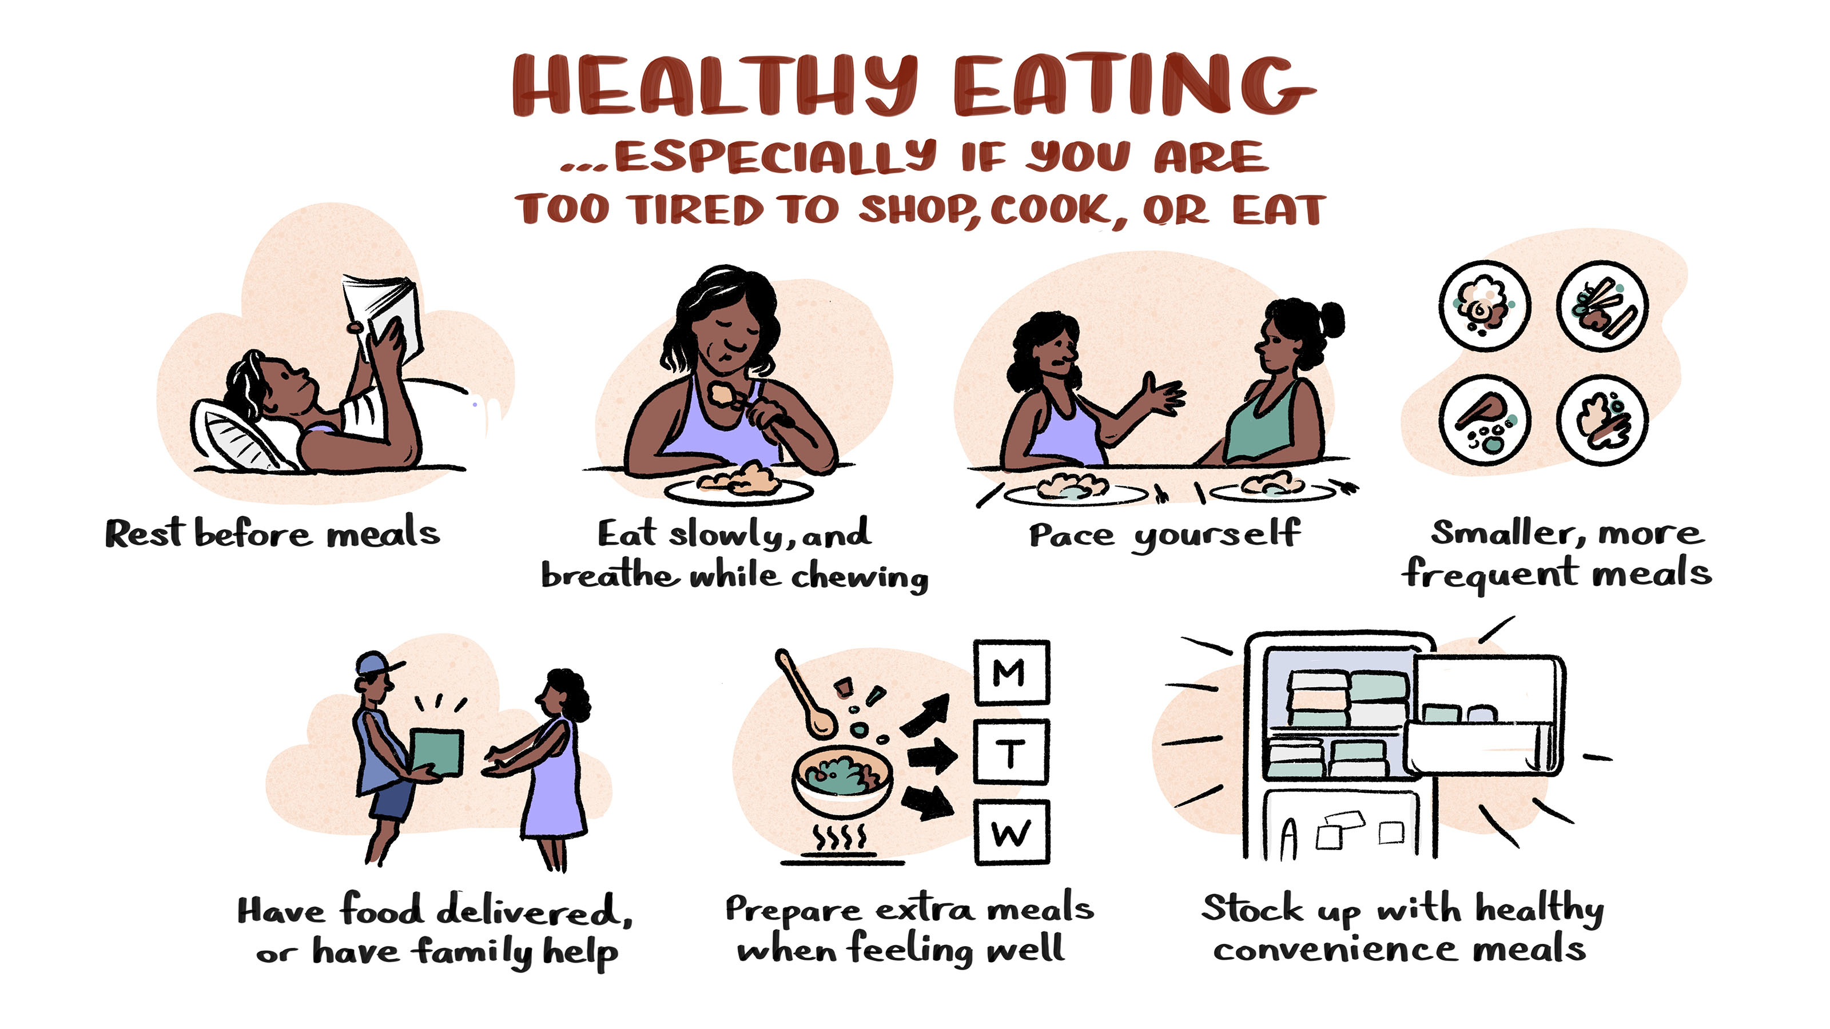
Notes:
Healthy Eating – Yarning illustration 9
It is important that a person with COPD eats food that is healthy to keep them well. Some people with COPD find it hard to eat and prepare food because of breathlessness.
Some ways to manage healthy eating when breathless, are:
resting before meals,
eating slowly, or pacing and breathing while chewing,
having smaller and more frequent meals,
having food provided or assistance with preparation of meals,
preparing extra meals when feeling well,
stocking up healthy and convenient meals.
The healthcare team (including a physiotherapist or exercise physiologist) can help with these strategies. In some cases, a person with COPD may be referred to a dietitian for support.

Slide 17
Learning from Aboriginal and Torres Strait Islander peoples living with COPD
Breathe Easy Walk Easy Lungs for Life (BE WELL) resources for Aboriginal and Torres Strait Islander Health Workers and Practitioners
Notes:
The following illustrations are based on what Aboriginal and/or Torres Strait Islander peoples expressed in experience of care interviews about living with COPD¹.
These resources could help health professionals understand Aboriginal and/or Torres Strait Islander people’s points of view and inform conversations with patients.

Slide 18
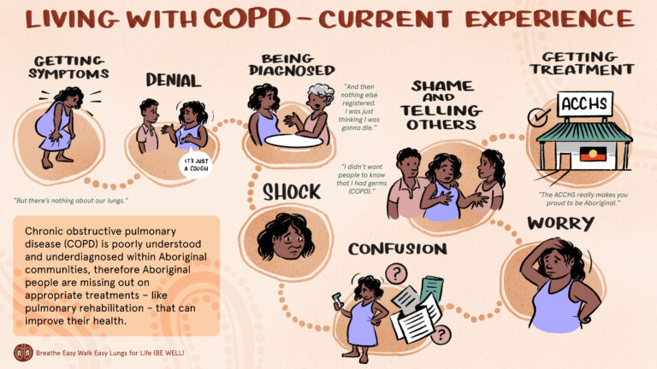
Notes:
Getting symptoms: Aboriginal and/or Torres Strait Islander peoples may have limited knowledge about COPD and often think the symptoms of breathlessness and cough are a normal part of ageing. They also may not know that there are things that can help them to live well with COPD.
Being diagnosed and shock: When Aboriginal and/or Torres Strait Islander peoples get a diagnosis of COPD (or emphysema), many think they will die because that is what they have seen happen to their relatives.
Confusion: They may be confused about all the new information and medications (such as inhalers).
Worry and shame: They may be worried and feel ‘shame’ about how COPD may change their relationships with family and friends. They may need support on how to talk with their family, friends and community about COPD. They may need support to know that COPD is manageable, and that things can be done to reduce symptoms and live well with COPD.

Slide 19
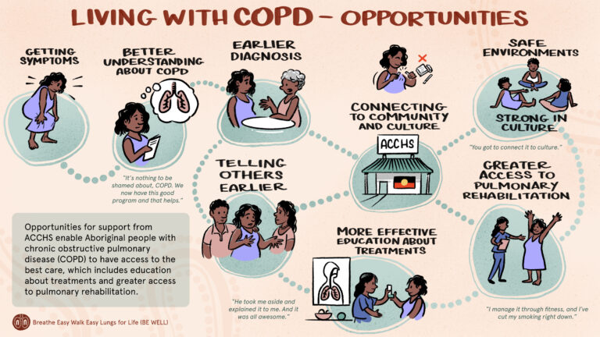
Notes:
Better understanding: When Aboriginal and/or Torres Strait people understand COPD better and know how to live well with COPD, it may be easier to see a doctor earlier and not feel so worried about telling others.
ACCHSs at the centre of culturally safe care: Going to the local ACCHS will help those with COPD to make sure they are on the most effective medications, can exercise at local pulmonary rehabilitation classes (if it is available), and connect with other Aboriginal and/or Torres Strait Islander peoples living with COPD in a culturally safe environment.

Slide 20
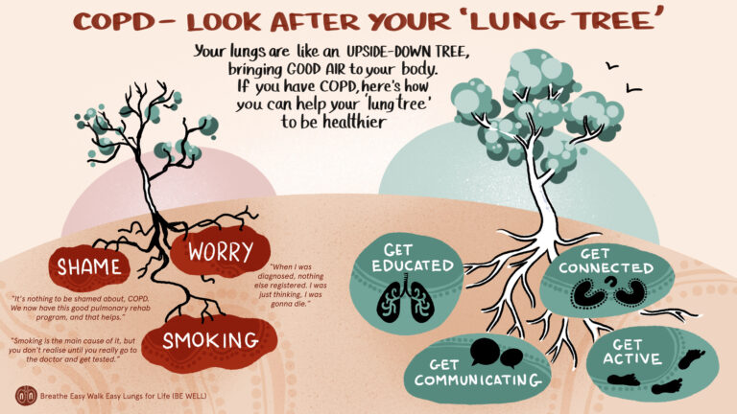
Notes:
When talking with Aboriginal and/or Torres Strait Islander peoples about their lungs, look for ways to connect the environment (as metaphors) to explain how the lungs work.
As a health professional you may like to explain to people with COPD how the lungs are like an upside-down tree:
‘The lungs are like an upside-down tree bringing air into your lungs along the branches (airways) so that oxygen can get to the leaves (air sacs) where in gets into the blood and is taken around your body to where it is needed’.
The illustration on the left is about Shame, Worry & Smoking. It is what Aboriginal and/or Torres Strait Islander people with COPD said after they learnt more about COPD. They reflected that although they felt Shame when they were diagnosed with COPD, they now realise that there are opportunities to manage COPD and that many people in their community have the disease.
People also reported that if they had knowledge about COPD and good management when they first experienced symptoms, they would not have worried (Worry) as much and would know that a COPD diagnosis is not a death sentence. Until Aboriginal and/or Torres Strait Islander peoples were tested with spirometry, they didn’t realise how much Smoking had affected their lungs (see quotes in the illustration).
As a health professional, encourage Aboriginal and/or Torres Strait Islander communities to ‘look after your lung tree’. The messages are:
get educated about COPD and what can be done to live well with the disease,
get communicating with others especially the health professionals in the ACCHS,
get active – we know that being physically active and exercise training programs (pulmonary rehabilitation) can really improve the quality of life of people with COPD and help prevent hospitalisation,
get connected with culture and family and friends which improves well-being.

Slide 21
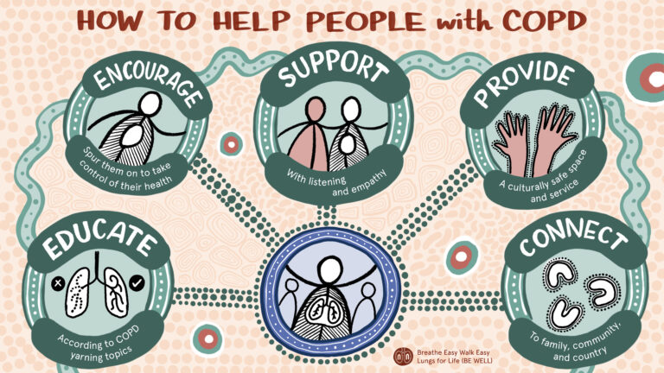
Notes:
The Aboriginal and/or Torres Strait Islander person living with COPD is at the centre of this illustration. As health professionals, to help people with COPD you can:
provide education according to the COPD yarning topics,
encourage people with COPD to take control of their health, for example to quit smoking, start exercising, know how to use inhalers, have an action plan, healthy eating etc.
refer the person with COPD to a pulmonary rehabilitation program
provide support through taking time to listen to the person with COPD and help them on their health journey with empathy.
engage your local Aboriginal and/or Torres Strait Islander health team or health worker (if you work in a local health district) to provide a culturally safe space and service and/or refer to the local ACCHS or work in partnership with the ACCHS,
encourage the person with COPD to stay connected with family, community and country.

Slide 22
ACKNOWLEDGEMENTS
These resources were developed with funding from the NHMRC Global Alliance for Chronic Diseases for a project tilted: Implementing evidence into practice to improve chronic lung disease management in Indigenous Australians: the Breathe Easy, Walk Easy – Lungs for Life (BE WELL) project.
The development of the resources was led by Professor Jennifer Alison and Dr David Meharg, with support from Lung Foundation Australia.
The scripts were reviewed by Aboriginal and Torres Strait Islander health professionals.
The Investigation team for the NHMRC GACD grant was: Prof Jennifer Alison, Prof Christine Jenkins, Prof Stephen Jan, Prof Graeme Maguire, Prof Tim Shaw, Prof Sarah Dennis, A/Prof Zoe McKeough, Dr Vanessa Lee.

Slide 23
Related publications
Meharg DP, Dennis SM, McNab J, Gwynne KG, Jenkins CR, Maguire GP, Jan S, Shaw T, McKeough Z, Rambaldini B, Lee V, McCowen D, Newman J, Monaghan S, Longbottom H, Eades SJ, Alison JA (2023). A mixed methods study of Aboriginal health workers’ and exercise physiologists’ experiences of co-designing chronic lung disease ‘yarning’ education resources. BMC Public Health 23(1): 612. DOI: 10.1186/s12889-023-15508-y
Meharg DP, Dennis SM, McNab J, Gwynne KG, Jenkins CR, Maguire GP, Jan S, Shaw T, McKeough Z, Rambaldini B, Lee V, McCowen D, Newman J, Monaghan S, Longbottom H, Eades SJ, Alison JA. A qualitative study of Aboriginal peoples’ health care experiences with chronic obstructive pulmonary disease. Qualitative Health Research. 2025 Feb;35(2):216-233: https://doi.org/10.1177/10497323241259891

